Slide 1

Open Systems Interconnection (OSI)
Thanmai D L

Slide 2
Agenda
[ Topics Covered ]

Slide 3
Agenda
Introduction
Upper Layers
Lower Layers
Encapsulation and Layered Communication
Conclusion

Slide 4
Introduction
[ What is OSI? ]

Slide 5
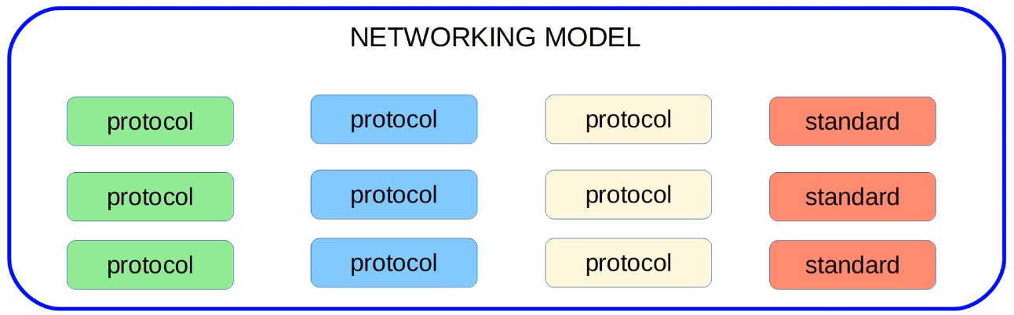
What is a Network Model?
Networking models categorize and provide a structure for networking protocols and standards.
It is a general-purpose framework that characterizes and standardizes how computers communicate with one another over a network.

Slide 6
A brief history
The OSI reference model is a standard of the International Organization for Standardization (ISO) and formalized in 1984.
It’s seven-layered approach to data transmission divides the operations into specific related groups of actions at each layer.
A layer serves the layer above it and is served by the layer below it.
OSI was an industry effort, attempting to get industry participants to agree on common network standards to provide multi-vendor interoperability.

Slide 7
Mnemonics
Here are a few mnemonics used to remember the seven layers of OSI:
All People Seem To Need Data Processing.
Please Do Not Teach Students Pointless Acronyms.
Please Do Not Touch Superman’s Private Area.
Please Do Not Throw Salami Pizza Away.
My personal favorite

Slide 8
Upper Layers

Slide 9
Layer 7
[ Application Layer ]

Slide 10
Layer 7
Application Layer
The application layer provides the interface between the user application and the network.
The user application itself does not reside at this layer – the protocol does.
The user interacts with the application, which in turn interacts with the application protocol.
Application-layer functions typically include file sharing, message handling, and database access, through the most common protocols at the application layer, known as HTTP, FTP, Telnet, etc.

Slide 11
Layer 6
[ Presentation Layer ]

Slide 12
Layer 6
Application Layer
Presentation Layer
The presentation layer prepares data for the application layer.
It defines how two devices should encode, encrypt, and compress data so it is received correctly on the other end.
Standards have been developed for the formatting of data types, such as text, images, audio, and video. Examples of presentation layer formats include:
Text - RTF, ASCII
Images - GIF, JPG
Audio - MP3, WAV
Movies - MPEG, MOV

Slide 13
Layer 5
[ Session Layer ]

Slide 14
Layer 5
Application Layer
Presentation Layer
Session Layer
The session layer creates communication channels, called sessions, between devices.
It is responsible for opening sessions, ensuring they remain open and functional while data is being transferred, and closing them when communication ends.
It also provides for full-duplex, half-duplex, or simplex operation, and establishes procedures for checkpointing, suspending, restarting, and terminating a session between two related streams of data.

Slide 15
Lower Layers

Slide 16
Layer 4
[ Transport Layer ]

Slide 17
Layer 4
Application Layer
Presentation Layer
Session Layer
Transport Layer
The transport layer does not actually send data, but it is responsible for the reliable transfer of data, by ensuring that data arrives at its destination error-free and in order.
This may require breaking large data units or long data streams into smaller chunks called segments.
Layer 4 communication falls under two categories Connection-oriented and Connectionless.
Layer 4 Protocols:
Transmission Control Protocol (TCP)
User Datagram Protocol (UDP)

Slide 18
Layer 3
[ Network Layer ]

Slide 19
Layer 3
Application Layer
Presentation Layer
Session Layer
Transport Layer
Network Layer
The network layer provides connectivity and path selection between two host systems that may be located on geographically separated networks.
It manages the connectivity of hosts by providing logical addressing.
It breaks up segments from the transport layer into smaller units, called packets, on the sender’s device, and reassembling these packets on the receiving device.
The most significant protocol at layer 3 is the Internet Protocol, or IP.

Slide 20
Layer 2
[ Data-Link Layer ]

Slide 21
Layer 2
Application Layer
Presentation Layer
Session Layer
Transport Layer
Network Layer
Data-Link Layer
While network layer is concerned with transporting data between networks, the data-link layer is responsible for transporting data within a network.
It breaks up packets into frames and sends them from source to destination.
This layer is composed of two parts:
Logical Link Control (LLC), which identifies network protocols, performs error checking and synchronizes frames.
Media Access Control (MAC) which uses MAC addresses to connect devices, transmit and receive data.

Slide 22
Layer 1
[ Physical Layer ]

Slide 23
Layer 1
Application Layer
Presentation Layer
Session Layer
Transport Layer
Network Layer
Data-Link Layer
Physical Layer
Physical layer defines physical characteristics of the medium used to transfer data between devices.
For example, voltage levels, maximum transmission distances, physical connectors, cable specifications, etc.
Digital bits are converted into electrical (for wired connections) or radio (for wireless connections) signals.
Layer 1 is closely related to the data-link layer, as many technologies (such as Ethernet or 802.11) contain both data-link and physical functions.

Slide 24
Encapsulation & Layered Communication
[ PDU’s ]

Slide 25
Encapsulation – Real World Scenario

Slide 26
Conclusion
[ Why OSI? ]

Slide 27
OSI Model Benefits
Engineers do not need to design a technology to work end to end from top to bottom of the model. They can just focus on their layer of expertise, and make sure they comply with the standards for the layers above and below.
This leads to open standards and multi-vendor interoperability.
Troubleshooting is easier because you can analyze a problem in a logical fashion layer by layer.

Slide 28
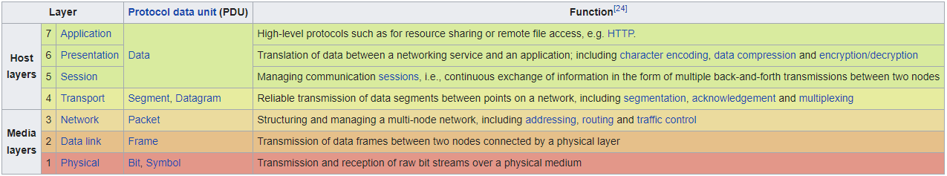
Summary

Slide 29
THE END

